Slide 1
Pioneers into Practice 2016
Hungary

Slide 2
Pioneers into Practice is the professional mobility programme of Climate-KIC, aiming to create a team of agents for change.

Slide 3
Programme Overview
4-6 week placement in your home region or abroad, at a suitable host organisation
Individual and group projects focused on real-world challenges
Intensive workshops and online courses
Supported mentoring programme
Up to 2000 EUR grant to cover expenses
Extended communication and networking opportunities

Slide 4
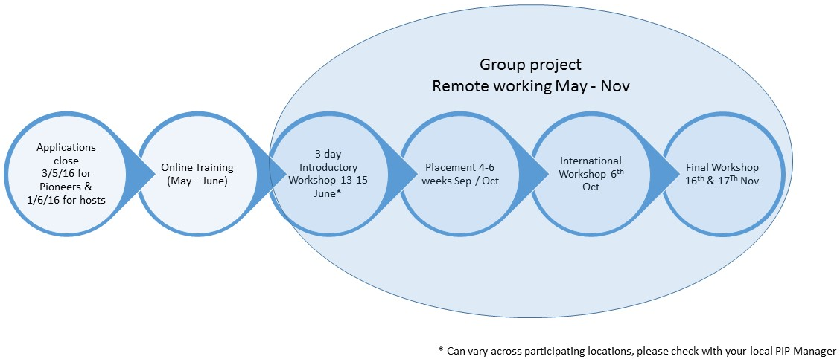
Programme Overview

Slide 5
Who’s involved?
Participating Regions;
UK
Poland
Spain
Italy
Hungary
Germany
Netherlands
Finland

Slide 6
Becoming a Pioneer
You have a University degree in the field of climate change/sustainability OR other equivalent degree in another field PLUS at least 2 years of work experience on climate change/sustainability
You are fluent in English (at least B2 equivalent)
You are able to commit to completing all programme elements
You live in one of the participating locations
You are open-minded and keen to learn, share, enjoy!
You get to use your skills on something different, creating a new set of partnerships that will serve throughout your career, all with a grant of up to €2,000 towards your costs.

Slide 7
Why Participate?
Breaking boundaries and bringing fresh perspective!
Be part of an international community of low carbon innovators
Receive training from leading European experts
Unrivalled networking opportunities
Join Europe’s largest public-private innovation partnership, working together to address climate change!
Meet fellow experts from public administration, private firms, non-profit, and academia

Slide 8
Previous Hungarian Hosts (selection)

Slide 9
Previous International Hosts (selection)

Slide 10
Application process
Online application: https://pioneers.climate-kic.org
Deadline: 3rd May, midnight
Eligibility check
Group interviews: 9-13 May
Announcement: 17th May
Welcome event: 2nd half of May

Slide 11
How to write a successful application?
Sell yourself!
Detail everything!
Write a good Europass CV – include every relevant projects and activities

Slide 12
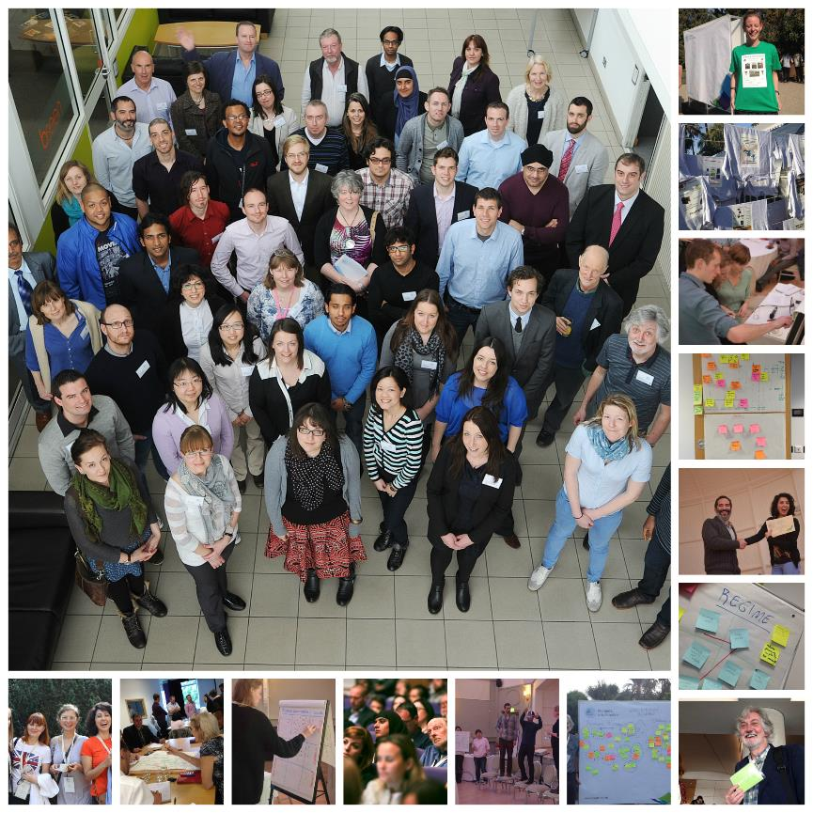
Join Us for 2016!
Places are limited, if you would like to take part as either a host or pioneer contact;
Edit Nagy
edit.nagy@ppis.hu
0036-30-304-1435
http://klimainnovacio.hu/hu/program/pioneers-into-practice
Applications open 4/4/16
and close 3/5/16.

